Slide 1
MUSIC PLAYER
Using System.IPT.PROJECT k18-1148 – k18-0321;

Slide 2
PROBLEM STATEMENT
Locals don’t have any cloud where they can upload their favorite music.
We created a solution where everybody can have their personal music cloud.
This project can also be used among family members with a single music storage with admin rights only given to parents.
This can implement parental control functionality.

Slide 3
TOOLS / TECHNOLOGIES
The tools and tech used In this project are as follows
MYSQL DATABASE ##for music , admin , user credentials storage
.NET WINDOWS FORMS ##for desktop music player
.NET ASP.NET ##for web end i.e. admin portal and online player

Slide 4
PROJECT FLOW
Our asp.net based web has 3 functionalities
1 user/admin authentication
2 admin can upload new music to database
3 user can play music online from database
Our desktop music player can also stream music from database
The music added to database will be reflected to all other platforms i.e. desktop music player and online music player

Slide 5
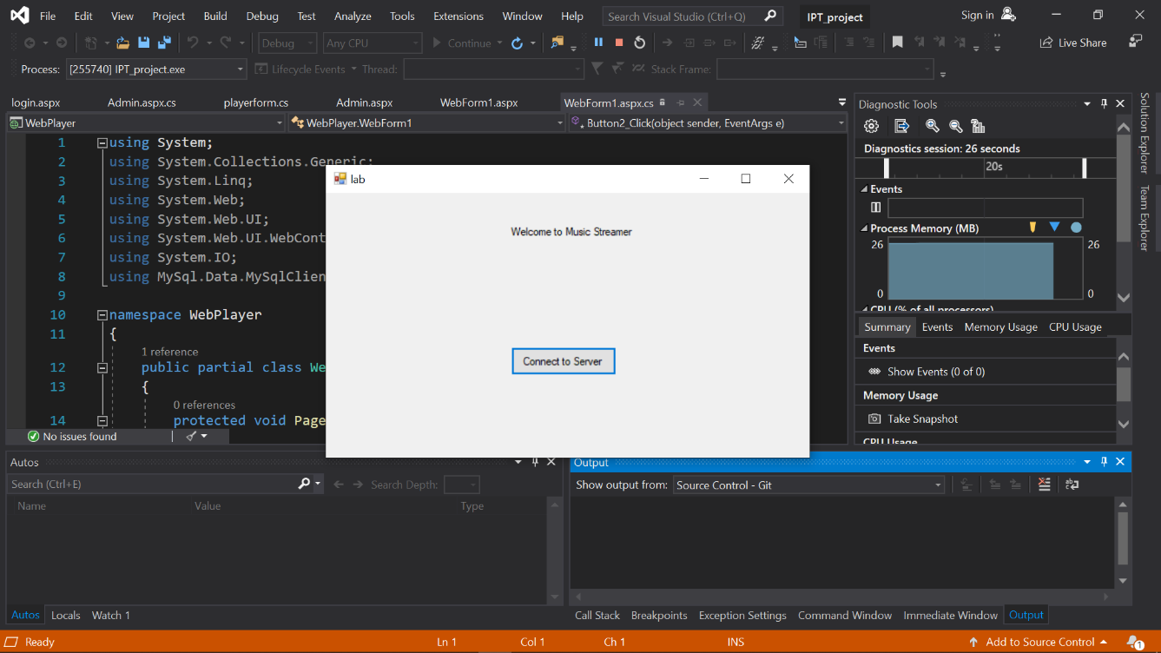
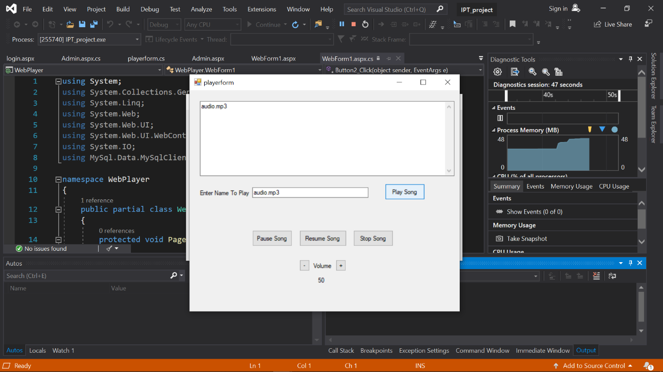
PROJECT SCREEN SHOTS

Slide 6
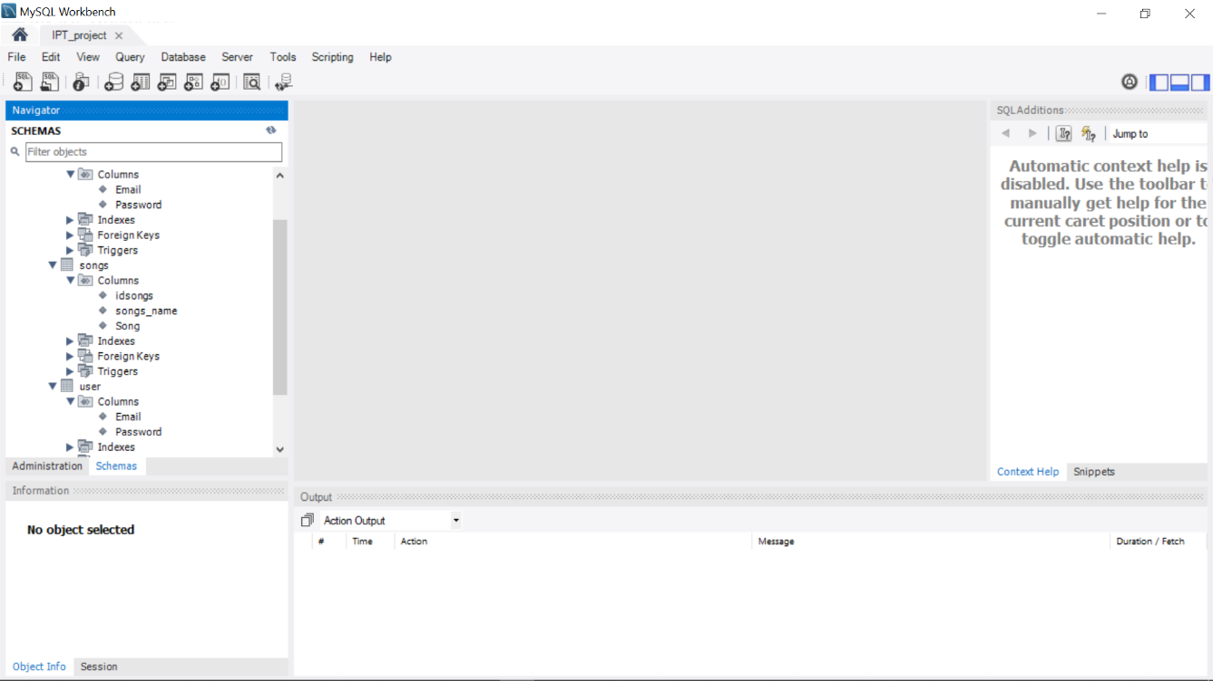
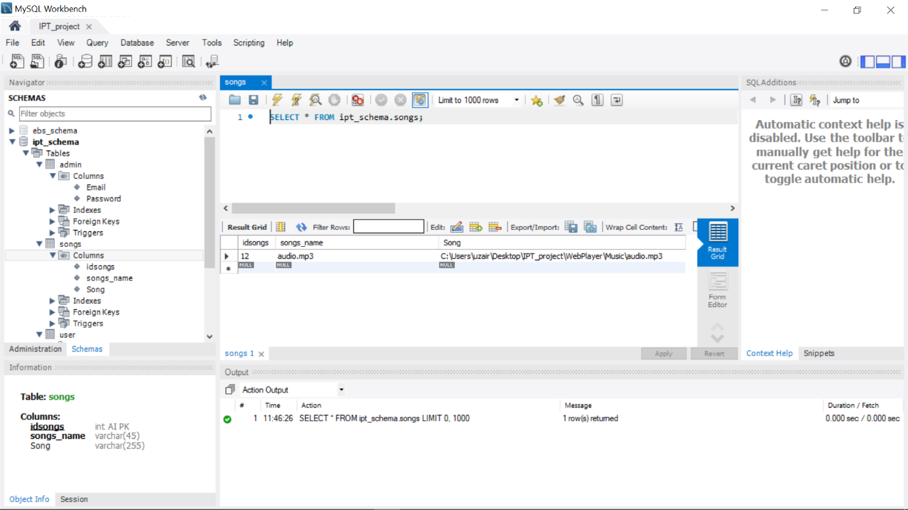
PROJECT SCREEN SHOTS

Slide 7
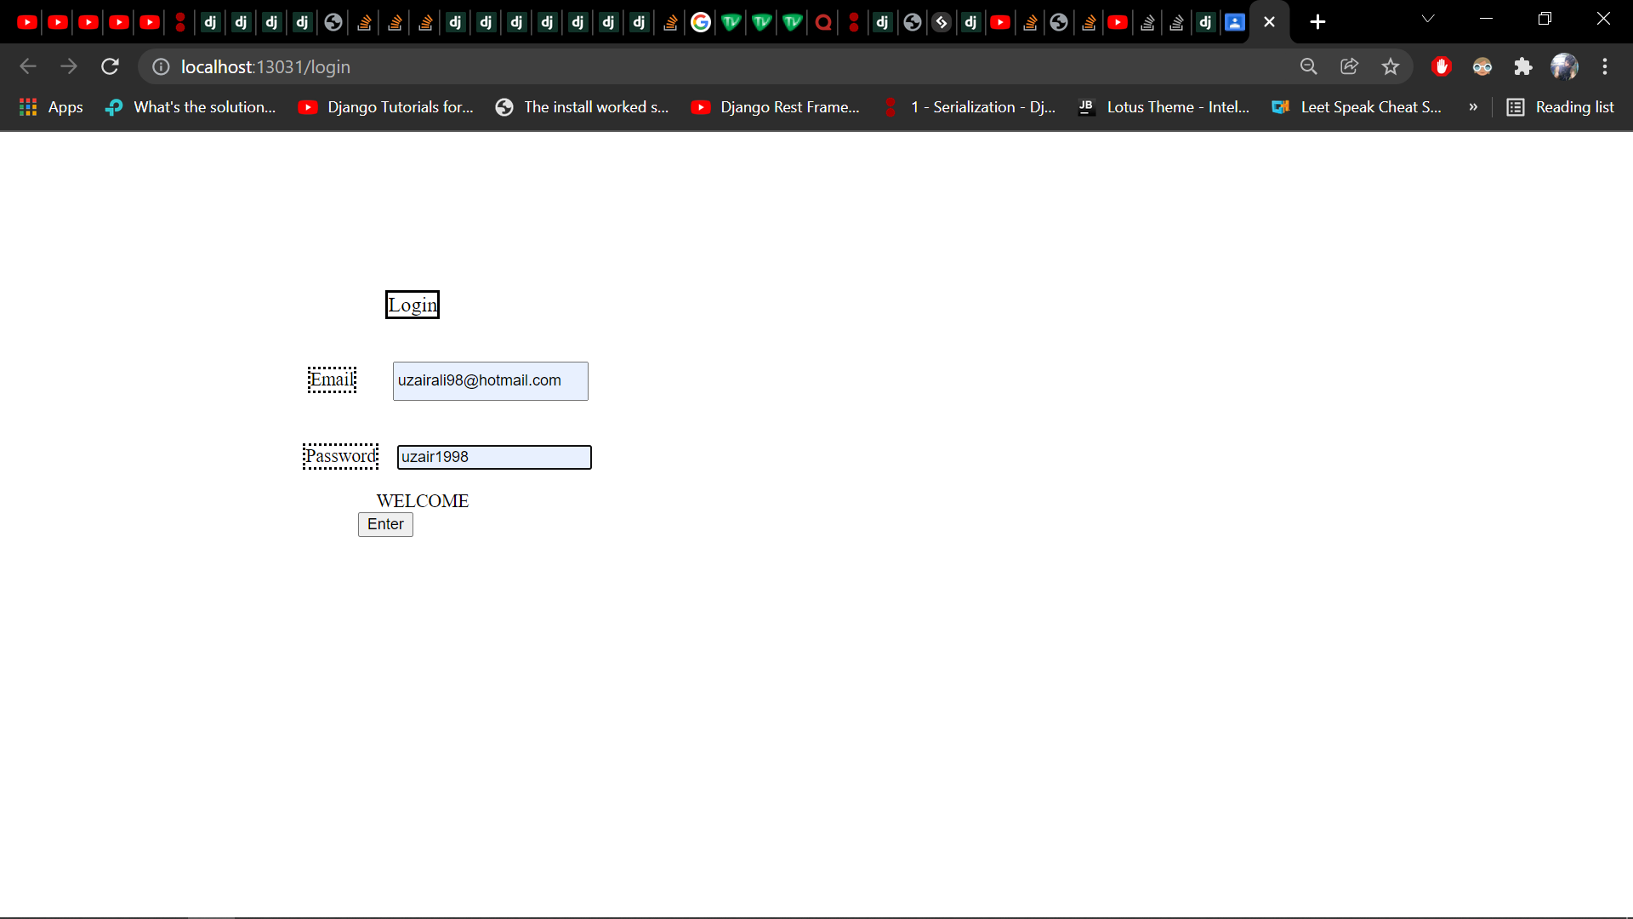
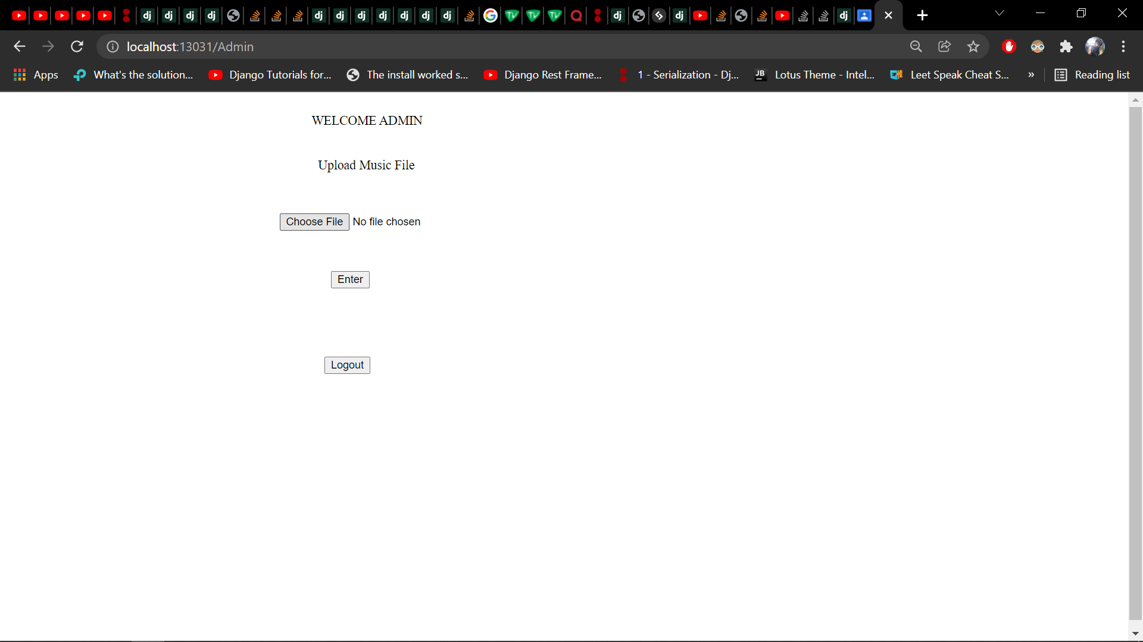
PROJECT SCREEN SHOTS

Slide 8
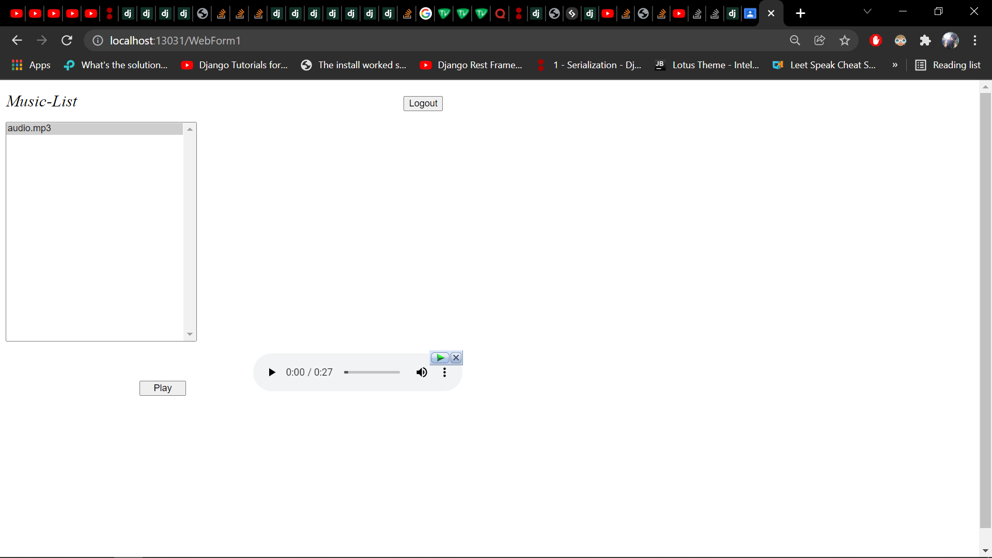
PROJECT SCREEN SHOTS

Slide 9
THANKYOU
System.exit()

